Slide 1
Microprocessor and Computer Architecture(ELX 301)
BIT 3rd Semester
Er. Suraj Basant Tulachan
Assistant Professor

Slide 2
Unit 5: Control Unit & Central Processing Unit
Outline:
  4.1 CPU Organization
  4.2 Register Organization
  4.3 Instruction Cycle
  4.4 Instruction Format
  4.5 Control Unit of Basic Computer
  4.6 Micro-Instruction and Micro-operation Format
  4.7 RISC and CISC

Slide 3
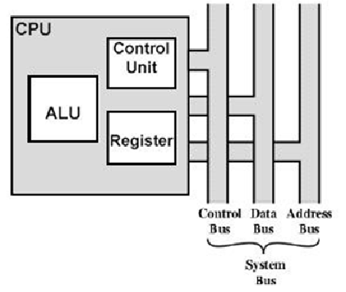
Central Processing Unit
Central processing unit consist of 3 components: ALU, Control unit and registers
Arithmetic Logic Unit perform arithmetic and logical operation.
Control Unit provide control signals and instructs the ALU to perform specific operation and transfer of information between the Registers and other unit.
Register store binary information and also provides fast information to ALU.
This components are connected with each other and external environments through system bus.

Slide 4
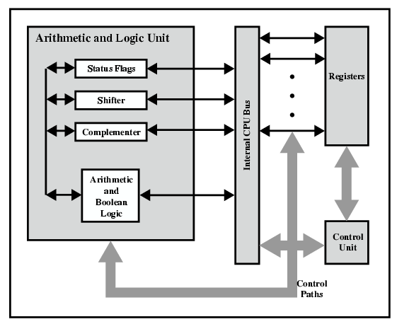
Central Processing Unit
Status flag: Stores status of any operation like zero, overflow, parity etc.
Shifter: Performs left and right shift.
Complementer: Performs bitwise complement.
Arithmetic and Boolean logic: Performs ALU operations.
Register: Collection of all registers like IR, MBR, MAR, PC etc.
Control unit: Provides control signals to all components like Read, write etc.

Slide 5
C.P.U Organization
There are three types of CPU organization based on the instruction format
Single Accumulator organization:-
In Single accumulator organization all the operations are performed within Accumulator register.
Basic computer is the good example of single accumulator organization.
The instruction of this type of organization has an address field.
E.g. ADD X AC←AC+M[X] where X is the address of the operand

Slide 6
C.P.U Organization
2. General Register organization
Large number of processor registers are included in the CPU.
Common Bus System is most efficient to connect them.
The Registers communicate with each other not only for direct data transfer, but also while performing
various micro-operations.
Common unit is necessary to perform all the arithmetic, logic and shift micro-operations in the processor.
In this type of organization the instruction has two or three address field.
E.g. 1. ADD R1, X (R1←R1+M[X]) 2. ADD R1, R2 ( R1←R1+R2 )
3. ADD R1, R2, R3 (R1←R2+R3)

Slide 7
C.P.U Organization
3. Stack Organization
In Stack Organization all the operation are performed with Stack.
A stack is a storage device that stores information in such a manner that the item stored last is the first item retrieved.
      It is based in Last-In, First-out (LIFO) mechanism.
      Operation type Instruction does not need address field.
      PUSH and POP Instructions only need address field.

Slide 8
C.P.U Organization
      Example
PUSH TOS←M[X]
POP X M[X] ←TOS
ADD
This ADD instruction in the stack organization performs addition of two top of the stack element and stores the result in the top of the stack.
First pops two operands from the top of the stack; adds them and stores the result in the top of the stack.

Slide 9
Instruction Format
Instruction Format:-
Instruction defines and perform the certain task or operation.
Instruction Format is the way how the instruction are encoded and represented in machine language.
Mode bit: It specifies the way the operand or the effective address is determined.
Op-code field: It specifies the operation to be performed.
Address field: It designates a memory address or a processor register.
Mode
Op-Code
Address

Slide 10
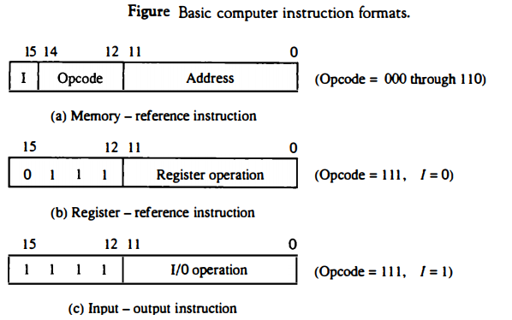
Instruction Format
The length of instruction varies with the variation of number of address in an address field

Slide 11
Instruction Format
There are four types of Instruction on the basis of address field.
1. Three-Address Instruction
Instruction with three Operand and an Op-code.
Operand may be Memory location or Register.
Advantage
It minimizes the size of program.
E.g. ADD R1, A, B / R1¬M[A]+M[B]
MUL X, R1, R2 / M[X]¬R1*R2
Disadvantage
Binary coded instruction requires too many bits to specify three address fields

Slide 12
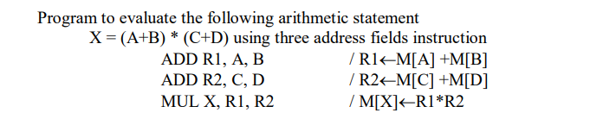
Instruction Format

Slide 13
Instruction Format
2. Two-Address Instruction
Instruction with two operand with op-code is Two Address Instruction.
Two operands specifies the instruction.
One operand acts as a source, and the other as a destination
Operands can be registers or memory locations.
E.g. 1. MOV R1, A / R1 M[A] 2. ADD R1, B / R1 R1+M[B] 3. MUL R1, R2 / R1 R1*R2
Advantage
It minimizes the size of Instruction.
Disadvantage
Size of the program will be relatively larger.

Slide 14
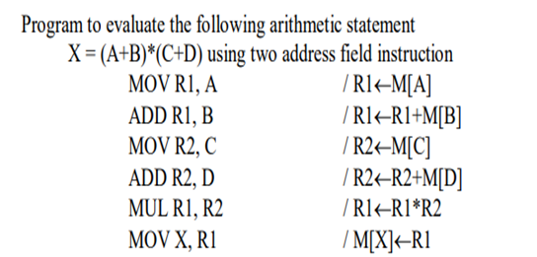
Instruction Format

Slide 15
Instruction Format
3. One-Address Instruction
Instruction with one operand with op-code is One Address Instruction.
Operand may be memory location or register.
Example:-
1. LOAD A / AC M[A] 2. ADD B / AC AC +M[B] 3. STORE T / M[T] AC
Advantage
Relatively small Instruction size.
Disadvantage
Relatively large program size.

Slide 16
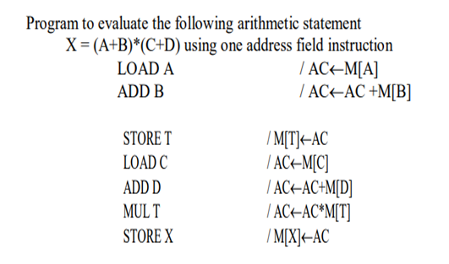
Instruction Format

Slide 17
Instruction Format
4. Zero-Address Instruction
It is also known as stack-based or accumulator-based instructions.
Operates directly on the top-of-stack or accumulator
No explicit operands specified in the instruction.
Operands are implied by the instruction itself.
Example: POP (Pop value from stack into register)
PUSH A / TOS←M[A]
2. POP X / M[X] ←TOS

Slide 18
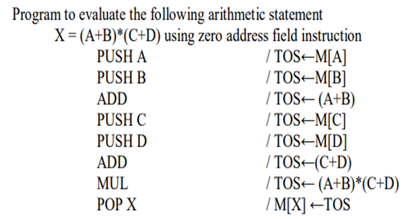
Instruction Format

Slide 19
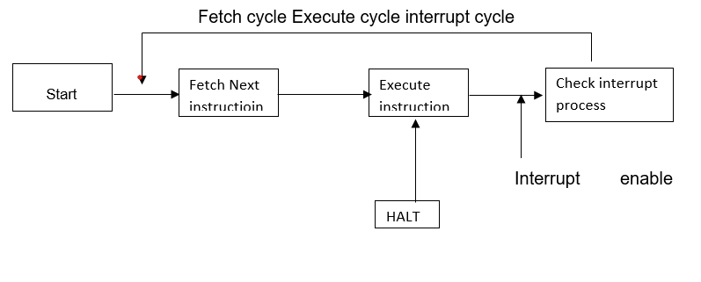
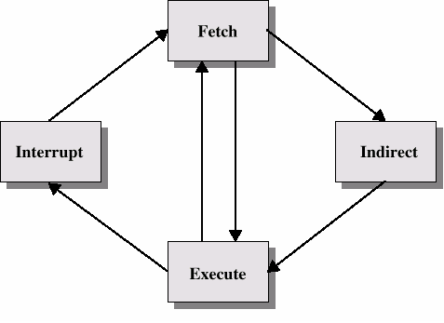
Instruction Cycle

Slide 20
Instruction Cycle
Instruction cycle:
The basic function performed by computer is execution of program which consists of set of instruction stored in memory.
The processing required for a single instruction execution is called an instruction cycle. Normally, an instruction cycle includes following sub cycles.
Fetch cycle: Read next instruction from memory into CPU.
Execute cycle: Decode the op-code and performs indicated operation.
Interrupt cycle: If interrupts are enable or an interrupt occurs halt the current process state and provide service for interrupt.

Slide 21
Control Unit
Control Unit instructs the memory, logic unit, and both output and input devices of the computer on how to respond to the program's.
The control unit generates the appropriate timing and control signals to all the operations involved with a computer.
Control unit directs the flow of data or instructions for the execution by the processor of a computer. It controls, manages and co-ordinates main memory, ALU, registers, input, and output units. It fetches the instructions and generates control signals for the execution.
The Control Unit is classified into two major categories:
Hardwired Control Unit.
Microprogrammed Control Unit.
Hardwired Control Unit :-
In a hardware organization control logic is implemented with logic gates, flip-flop, decoder and other digital services.
Provides fast mode of operation.
Inflexible in Design.
Complete Hardware needs to be changed to modify or change in program.

Slide 22
Control Unit
Microprogrammed Control Unit :-
In micro program control unit, the logic of control unit is specified by micro program.
A micro program consists of a sequence of micro instructions to execute.
Micro program is also known as firmware or midway between hardware and software.
In comparison to hardware it is easier to design where as in comparison to software it is difficult to write.
A control unit provides a set of control signals lines distributed through CPU with each of line representing binary digits 0 or 1.

Slide 23
Control Unit
Microprogrammed Control Unit :-
Advantages
The use of micro programming to implement control unit is easier to design.
It is both cheaper and less error prone to implement.
Since micro programs can be changed easily, it is therefore flexible in comparison to hardwired control unit.
Disadvantage:
This is slower than hardwired control unit because micro instruction are to be phase from control memory which is time consuming.

Slide 24
Reduced Instruction Set Computer (RISC)
Reduced Instruction Set Computer(RISC) has relatively few Instructions.
Reduced Instruction Set Computer(RISC) has relatively few Addressing modes.
RISC has Single-cycle instruction execution.
RISC is hardwired rather than micro programmed.
In RISC all the operations are done within the registers of the CPU.
RISC has Fixed-length, easily decoded instruction format.

Slide 25
Reduced Instruction Set Computer (RISC)
Reduced Instruction Set Computer(RISC) has efficient Instruction pipelining.
Reduced Instruction Set Computer(RISC) are slow.
RISC are cheap.
RISC are not powerful.
RISC are fast.

Slide 26
Complex Instruction Set Computer (CISC)
Type of computer architecture that emphasizes complex instructions.
It is capable of performing multiple operations in a single instruction.
A large number of instructions - typically from 100 to 250 instructions.
CISC has some instructions that perform specialized tasks and are not used frequently.
A large variety of addressing modes – typically from 5 to 20 different modes.
Variable-length instruction format.

Slide 27
Complex Instruction Set Computer (CISC)
Uses memory to load and store instruction and operand as well.
Complex Instruction Set Computer(CISC) is software based.
Micro-program is written using microinstruction.
CISC has multiple cycle Instruction.

Slide 28
THANK YOU

